Slide 1

THRIVE Elevating our presence, driving meaningful growth, and engaging through connection, innovation, and inclusion.
Lisa Lickert, President
Rotary Club of Cincinnati
2025 – 2026 Mid-Year Report

Slide 2
Have a plan. Work the plan.
Operations Plan – Building systems & processes with lasting power leveraging successes Consistent operations = larger community impact.
Sales & Marketing Plan – Established initiatives & set priorities
Marketing & Communication Strategy – led by Katy Crossen
Dashboard – Membership KPIs from G5 & added metrics tied to plan What gets measured gets improved.
BOD meeting review – Directors communicate with the Committee Chairs
Weekly operational meetings to identify & clear challenges & reset priorities
Quarterly succession planning lunches

Slide 3
We THRIVE by investing in our members, not just growing our numbers.
Introduced retention rate tracking this year
Average annual attrition rate in the US is 14–15% with a retention rate of roughly 85–86%
Our Club target is 87% and we are currently running at 86%
New Member Project & Creating a Cohort
Retention Committee
Membership Workshops (Growth Committee & Membership Committees)
Mobilizing efforts, Membership milestones, Leadership pathways

Slide 4
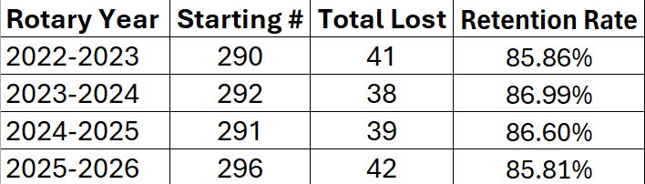
Retention Trends: US Avg 85-86% Prior Years vs. Current Year

Slide 5
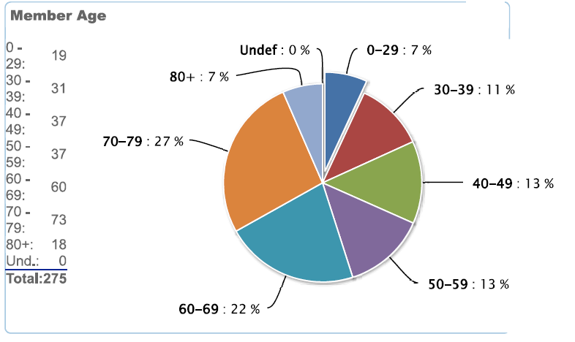
Member Age – Avg 5% <40

Slide 6
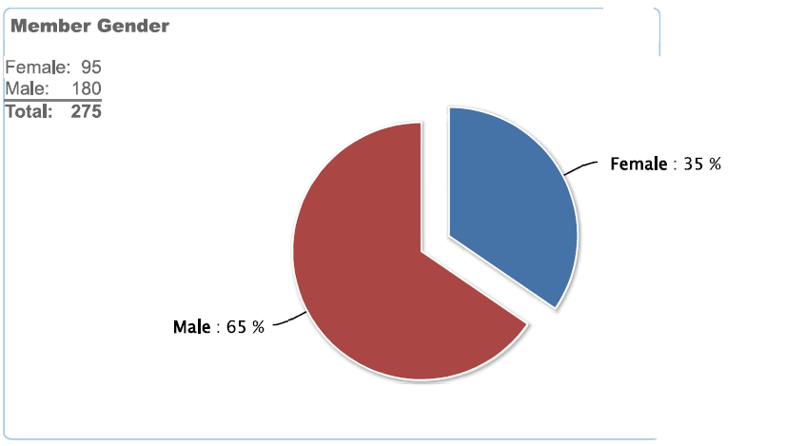
Member Gender – Avg 30-34%

Slide 7
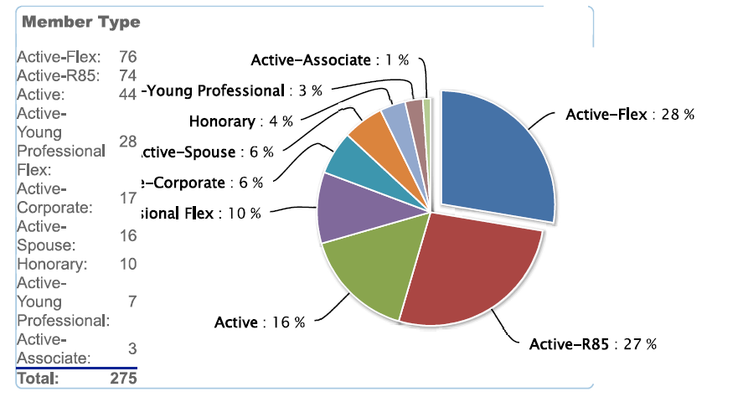
Membership Type

Slide 8
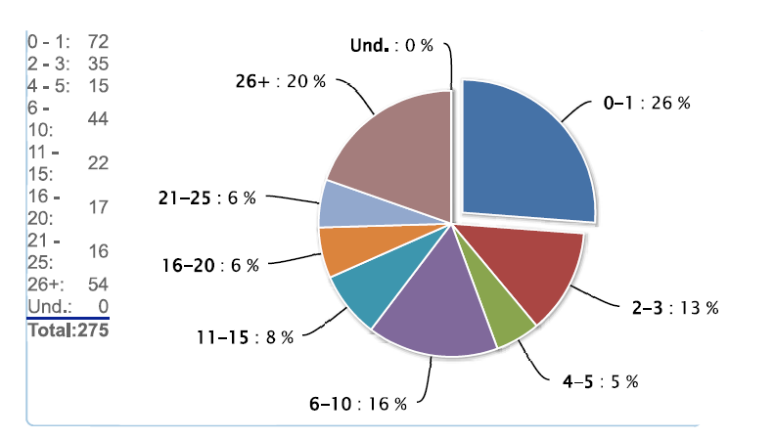
Years of Service – Avg 19.9 Years!

Slide 9
From Feedback to Forward Motion: Member Survey Results
Townhall to be scheduled – Post survey forum
Engagement preference ranking
Thursday Meetings: 80.0% → 83.1% (up slightly)
Fellowship: 48.9% → 56.6% (up)
Service: 55.6% → 49.4% (down slightly)
Support but rarely attend: 15.6% → 10.8% (down)
Perfecting the meeting experience
Moment of reflection, inspiration, or gratitude v. non-denominational invocation
Meeting flow

Slide 10

Our Growth Imperative
We must stop treating growth as a project. Growth is a permanent, strategic, business function.
New role focusing on delivering the sales & marketing plan – prioritizing new member growth & marketing systems
Intentional invitations
High volume, strategic outreach
Nurturing funnels & target follow up workflow

Slide 11

Mid-Year Financial Snapshot & Operating Metrics
Operating well and within our means
YTD income slightly ahead of plan
Expenses coming in below budget
87% retention goal = 86%
6-month new members = 22
July & January losses = 42
Target is 18 net new
7 new members/ month (Feb – June)

Slide 12
Meeting Sponsorships: A Win - Win
Why it matters - Sponsorships strengthen the financial health of our Club while giving members’ businesses trusted, warm-market exposure to an engaged, influential Rotary audience.
Signature Sponsorship – $1,000 Year-round visibility including a 3-minute speaking opportunity, website + newsletter logo placement, table branding, and a custom Rotary social media highlight. Comparable market sponsorships often cost this much for logo placement alone.
Featured Meeting Sponsorship – $350 A cost-effective, familiar option to stay visible and support the Club.

Slide 13


As we look ahead to the rest of this Rotary year, my ask is simple: stay engaged, stay curious, and lean in. The strength of this Club has always come from the people in the room - your ideas, your leadership, and your willingness to show up for one another and for our community. If we continue to lead with intention, support one another, and say yes to the opportunities in front of us, we won’t just finish the year strong - we’ll set the foundation for a Rotary Club that continues to THRIVE well beyond this year.
THANK YOU!

Slide 14
Committee Updates
Service In Action

Slide 15
Special Activities (fun and feel good)
Josh Vogel, Director of Special Activities
Fire/Police/Sheriff Recognition
Camp Allyn Ballon Rides
Professional Development Series
Rotary Picnic
Rotary Club of Cincinnati Do Days

Slide 16
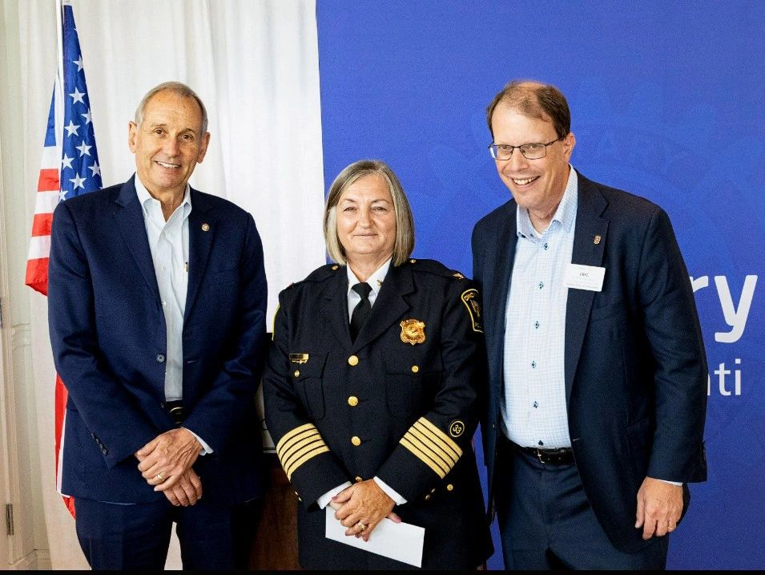
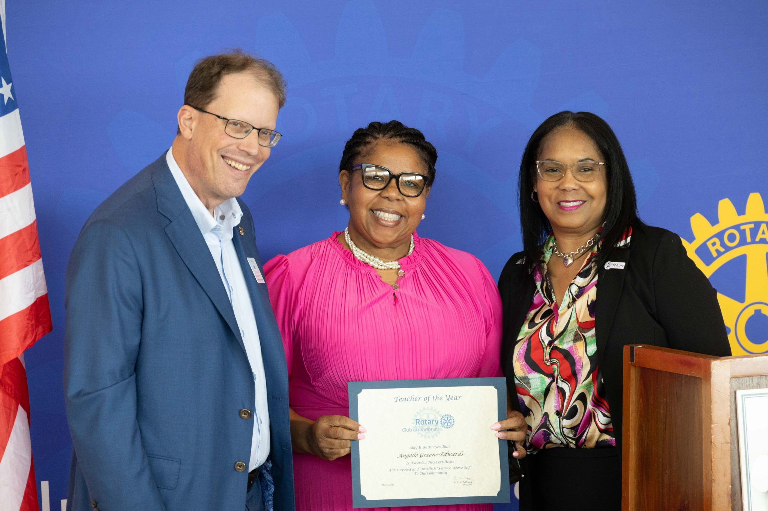
Fire, Police, Sheriff Recognition
Michael Vilardo, Co-Chair
Alison Kaufman, Co-Chair

Slide 17
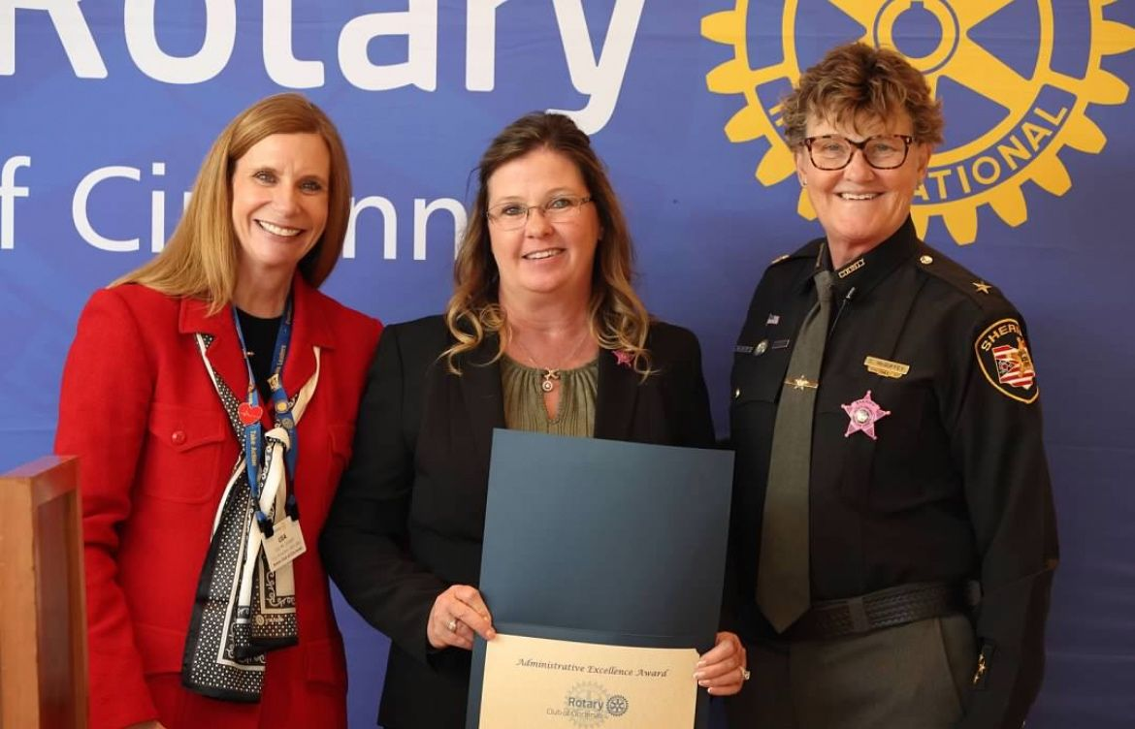
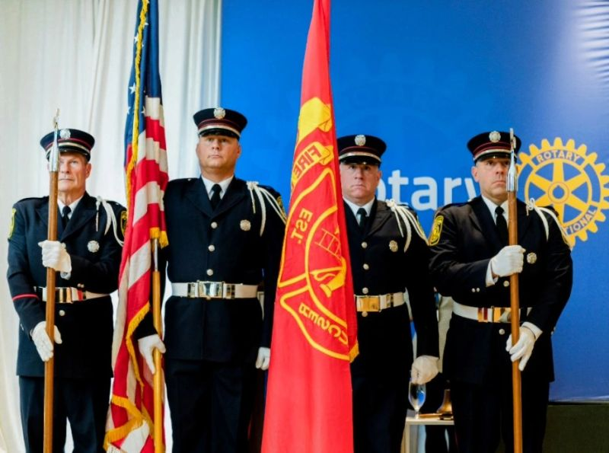
Fire, Police, Sheriff Recognition

Slide 18
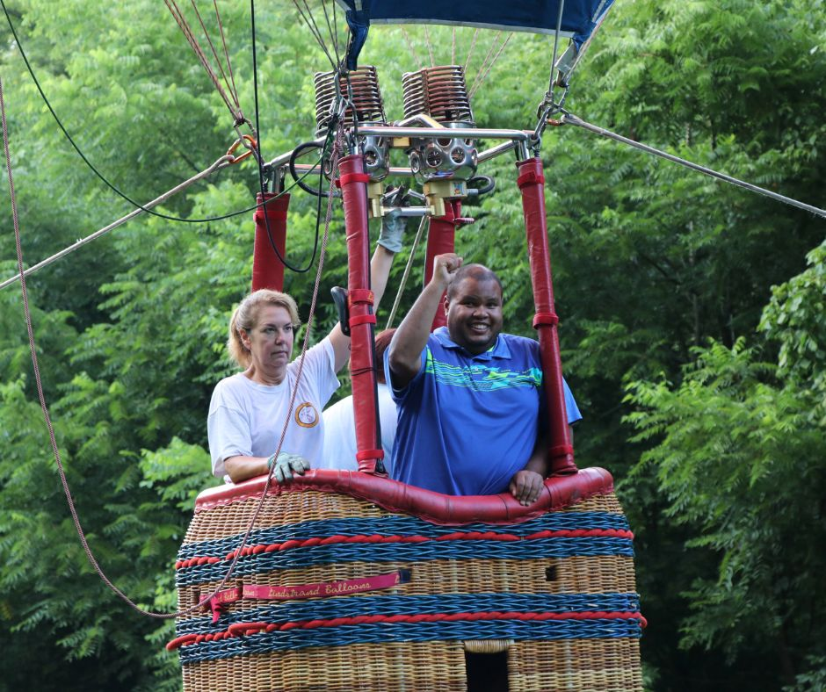
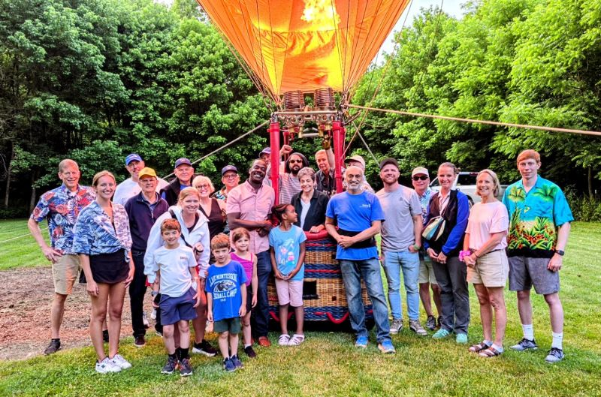
Camp Allyn Ballon Rides
Mark Soupene, Chair
Club has hosted ballon rides for over 30 years!
Tuesday Nights Throughout the Summer

Slide 19
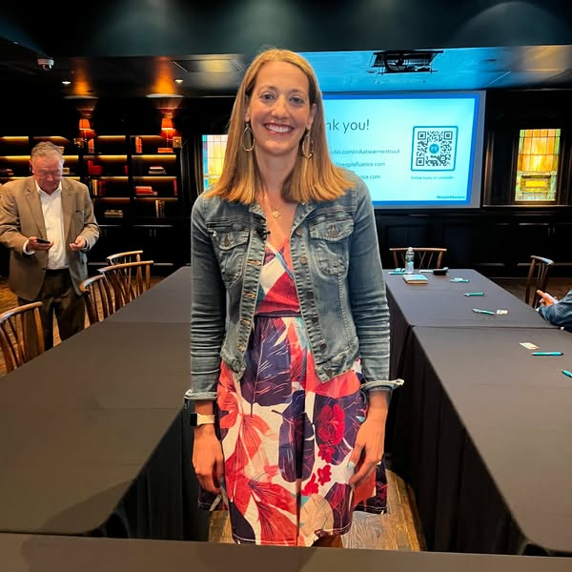
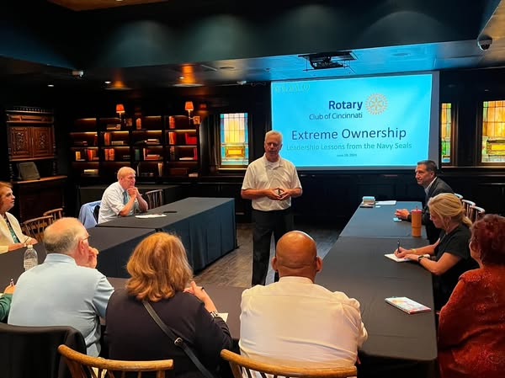
Professional Development Series
Bob Sheard, Chair
Emily Moss: Power Lunch
Katie Armentrout: Meeting Overload
Alan Lindeman: Leadership Principles with Extreme Ownership
Power of Lifestyle: It’s Your Best Medicine
Triple Teaming the IRS for Future Prosperity
AI is Here to Stay
Future collaboration with WIR – 3/5/26

Slide 20
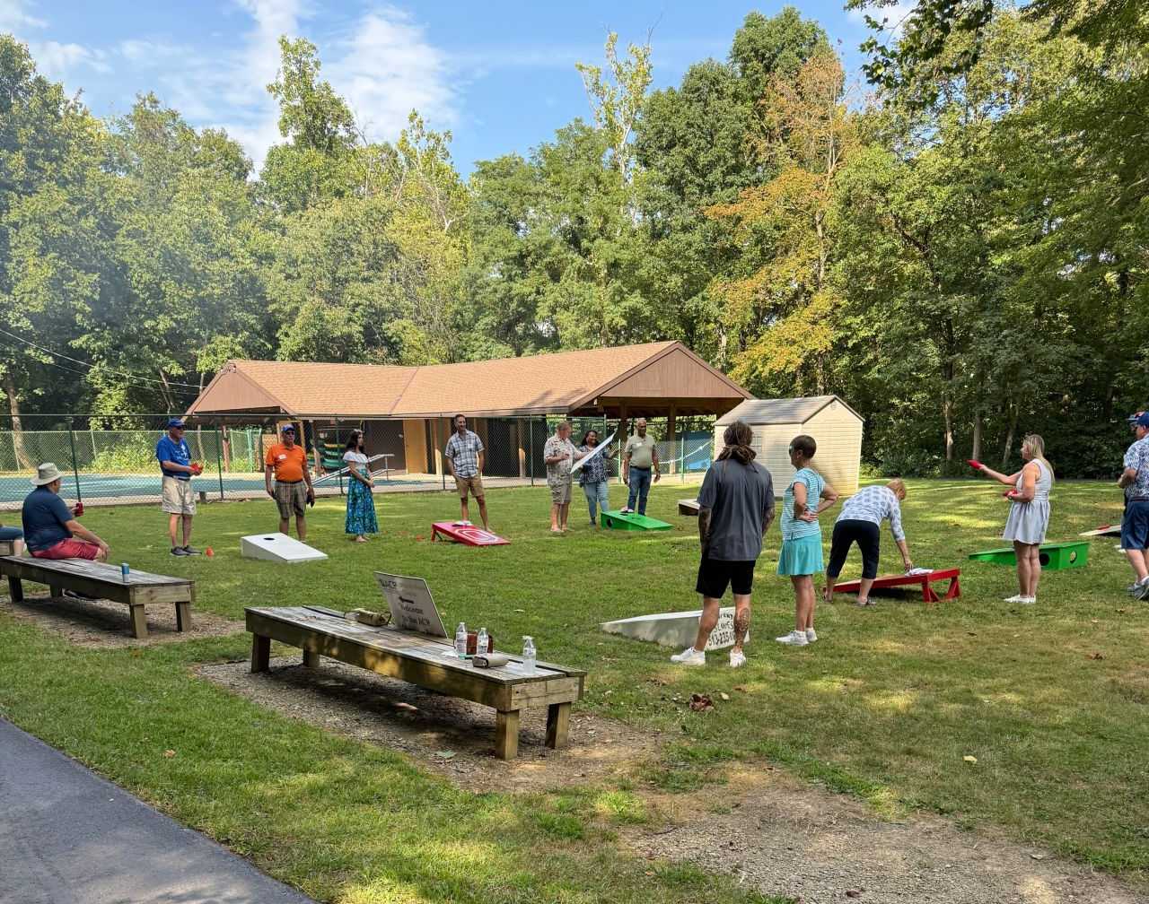
Rotary Picnic
Looking for a 2026 Chair
2025 Had 100 Guests including
Rotarians, family and friends.
Save the date:
September 12, 2026
Location: Camp Allyn
Family Friendly
Cornhole Competition
Adult & Children Activities
More To Come
Join the Committee

Slide 21
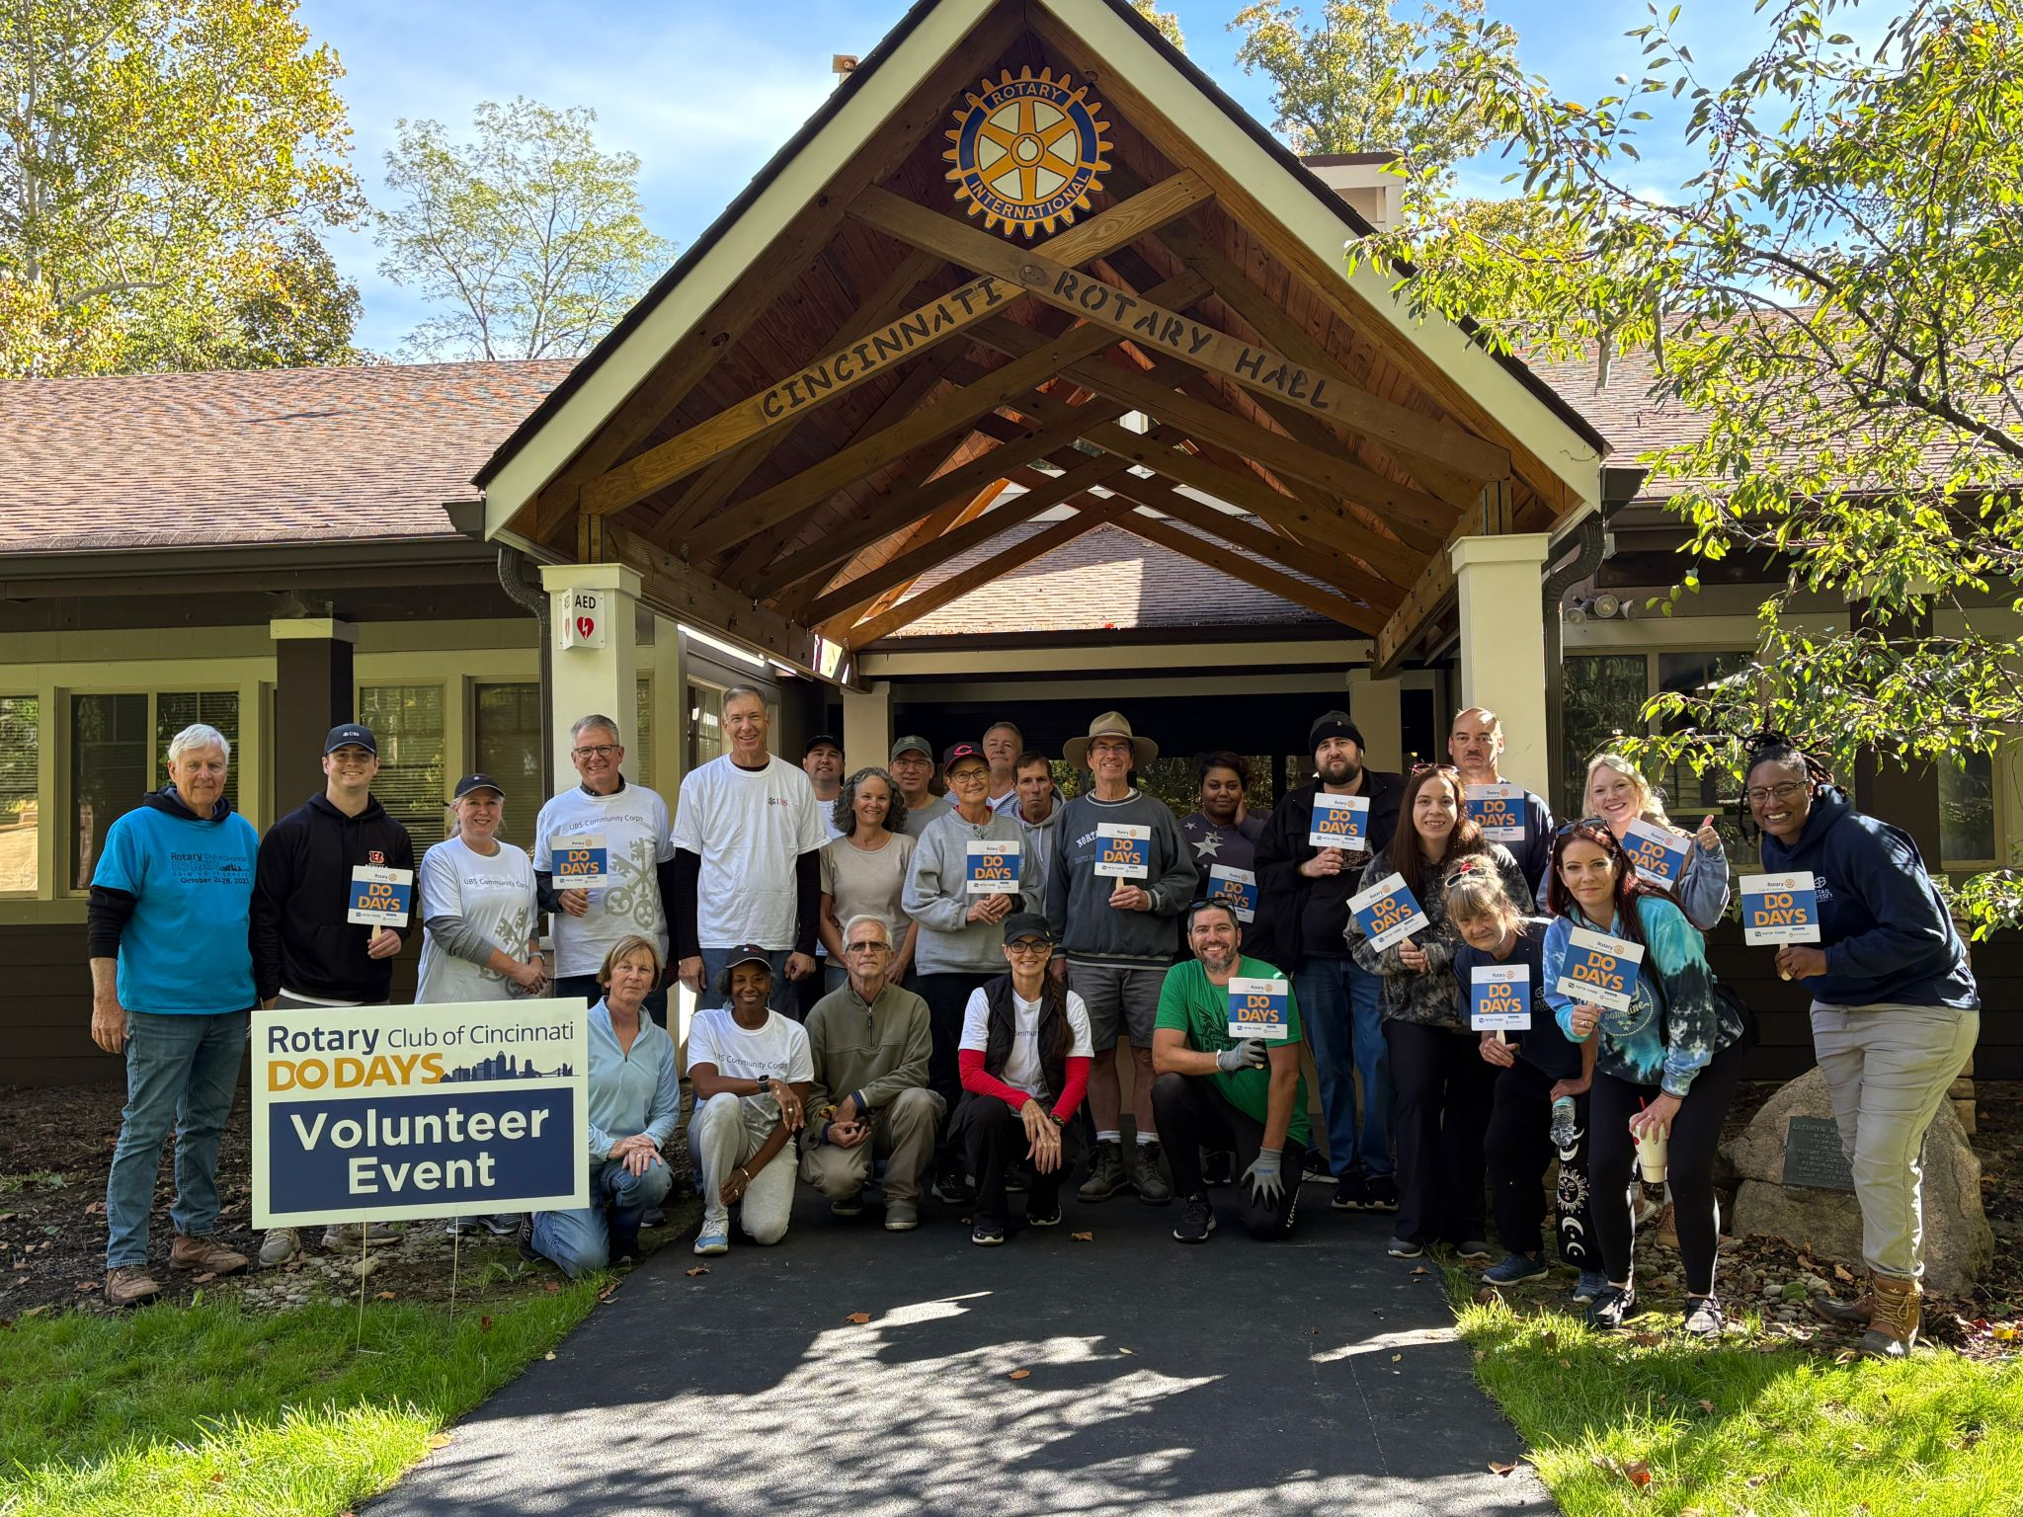
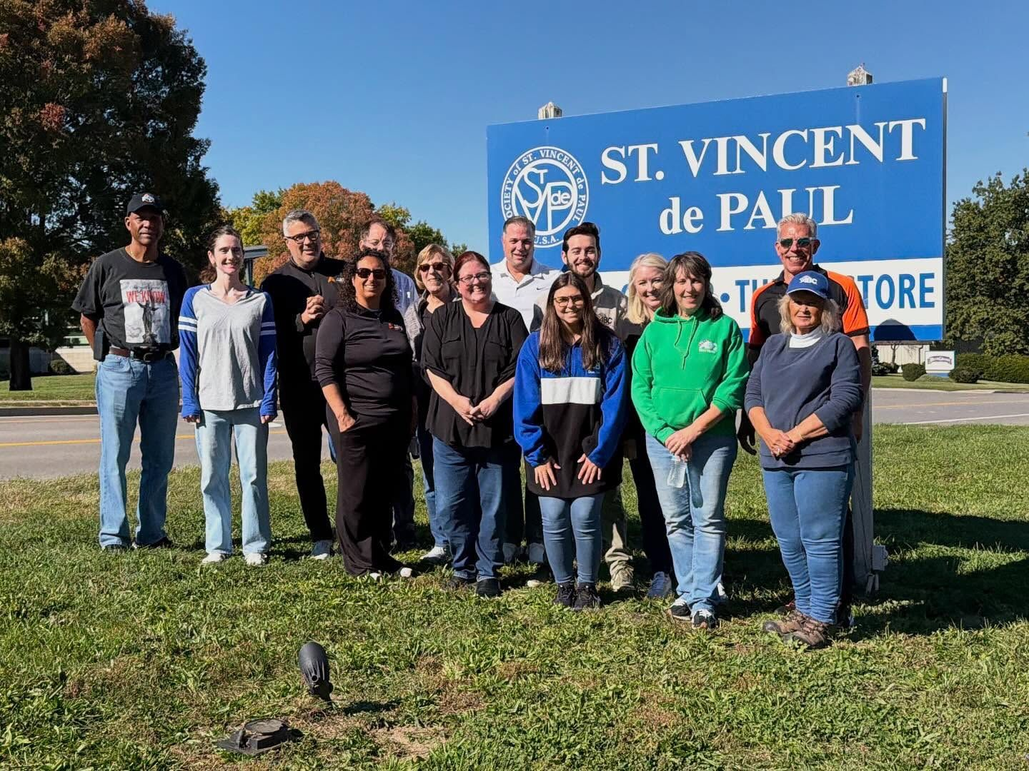
Cincinnati Rotary Do Days
Kelly Mahan, Co-Chair
Lisa Lucas, Co-Chair
October 16, 17, 18
35+ Non-Profit Projects
444+ Voluneteers
Total Economic impact:
1440.75 hours (volunteers + ambassadors) + 759.25 hours (committee planning) + 280 hours (ambassador prep) = 2480 hours
2480 hours x $34.79 community impact rate = $86,270.20 community impact value!

Slide 22
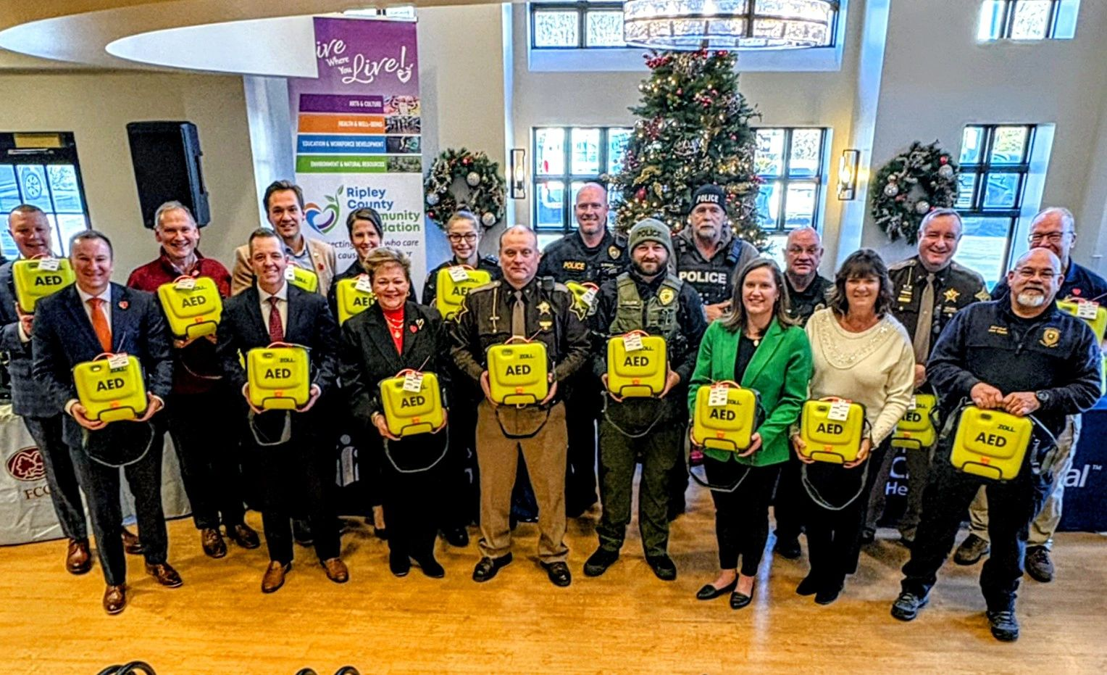
Project Heart ReStart
To Date Have Raised Over $1 Million Dollars and Donated 506 AED
Active Projects in Kentucky, Ohio and Indiana
Picture on the Left is from the Ripley/Franklin County Phase
74 Units Donated

Slide 23
Membership Growth
Chuck Martz, Director of Membership Growth
1st Half of 2025 -2026 : Across Marketing & Comms, Retention, Rotarians at Work, Connect & Coffee, and Women in Rotary, we’ve built real momentum—stronger visibility. In the 2nd half we will focus on better follow-through with members, more hands-on service, and more high-energy connection points—so we’re set up to turn participation into sustained growth.

Slide 24
Membership Growth: Committees and bullet points
Marketing and Communications
Growth and marketing strategy is now in place along with an active Business Development Role.
Membership has increased in the 1st half
Member Retention
Great work, reaching out to current members who’s activity has dropped off.
The check ins are helpful and appreciated by our members.
Rotarians at Work
Rotary Connect & Coffee Events
Monthly Coffees have been very well attended ( ~ 30 people/event)
Rotary Connect events will now be held routinely on the first Tuesday of the month.
Women in Rotary
Collaborating with Professional Development for a Women Business Leader’s event 3/5
Book club both in person and virtual to encourage participation

Slide 25
Club Meetings: Stephanie Sheard, Director
Music: Chorus continues to perform at meetings. ..if only to sing the Star-Spangled Banner. Veterans enjoyed the Armed Forces Medley at Veteran’s Day meeting. A few new members have joined the chorus. We welcome performing in first quarter 2026 at pleasure of the Board.
SAA: The committee has been running very smoothly, always plenty of Rotarian volunteers to fill in the role as SAA at each weekly meeting
Invocation: There was a role change shortly after August due to a rotarian moving, no longer able to serve in the role. Swiftly another Rotarian filled in, and the committee is doing well, running like clockwork!
Program: The program committee had a great lineup of guest speakers for the first half of the year and look to have the same in store for the rest of the year as well!
Greeter: Our new chair has been great and excited to be in the role, seeking Rotarians to fill in each week. Looking forward to the integrating more new members to serve as greeter each week, so they can get to know more members of Club 17.

Slide 26
International Service: Greg Hartley, Director
World Affairs Committee
Successful fundraising of over $50,000 in September 2025 for the projects and endowment.
Projects in Jamaica and Guatemala moving forward as planned.
The second half of the year will review existing and new projects for selection to be started in the 2026-2027 Rotary year.
We will have new Co-Chairs going into 2026-2027 Rotary year, Larry Brandstetter and Greg Hartley.

Slide 27
Club Social Activities: Hux Miller, Director
Gary Kindell chairs the bowling committee. 25-30 members bowl at Stones Lanes every Wednesday at 6:45 from September to April. And we bowl the Dayton Rotary Club every year. We could always use a few more bowlers. Experience not necessary. Fun.
Bryan Vielhauer chairs the Red Light Table. Fellowship, but less booze since Sara recruited the Women’s Christian Temperance Union as corporate members. The annual Red Light Party Saturday January 17th. Fun and adult beverages.
Euchre chaired by Nancy Reisz. Fun, easy to learn, and Nancy has organized a learning session Tuesday September 17th at the Carnegie Center at 5:30. (The Center on Eastern Avenue, not the Carnegie Hall)
Rotary After Hours. Members open their homes to members and friends. Potluck. Bring something to eat or drink. Fun, a chance to hang out with fellow Rotarians. Thanks to Katy Crossen, Bonnie Rettig, Ali and Saba Hussein, and Stephanie and Bob Sheard who hosted recently. Not to be missed.
Tracy Meguire and John Doherty hosted a bike ride on the Loveland trail, finishing with lunch at The Works restaurant. Fun , friends, and exercise.

Slide 28
Club Leadership & Committee Responsibilities
Board of Director | Committee Assignments
Club Executive Matters | Lisa Lickert
Membership Growth | Chuck Martz
Corporate Member Development & Engagement | Eric Pettway
Member Retention | Pat Neal-Miller
Club Operations | Bob Brandstetter
Club Meetings | Stephanie Sheard
Community Service | Michael Villardo (formally Brian Bowling)
International Service | Greg Hartley
Youth Service | Steve Easely
Club Social Activities | Hux Miller
Fundraising and Fun | Chelsea Janszen
Special Activities | Josh Vogel
Foundation Matters | Wes Botto, Foundation President

Slide 29

Where Growth Meets Purpose
We will THRIVE by approaching growth with strategy, purpose, and heart.
Together, we don’t just grow – we grow with intention, compassion, and impact!

